Slide 1
Daniel Carcamo
Spot-Light Web Project

Slide 2
About
Spot-Light is a web app where you can log and keep track of movies and shows that you have watched and/or plan on watching. Just type your movie, and with the help of the IMDb API, you can see all the details of the movie you have listed.

Slide 3

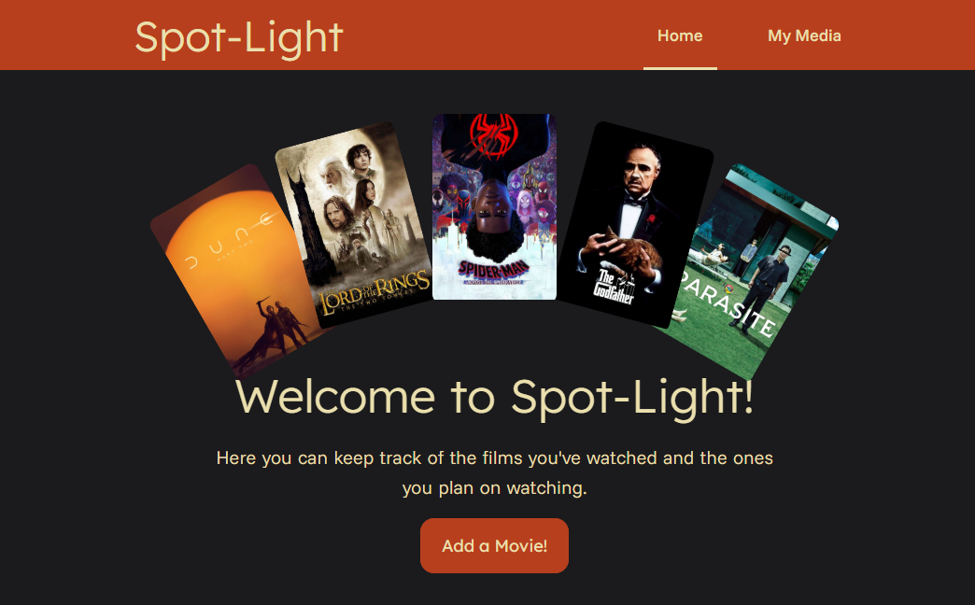
Home Page
This just a basic home page made using HTML and CSS, it contains some JS, however it is just used for a subtle hover effect on the menu bar.

Slide 4
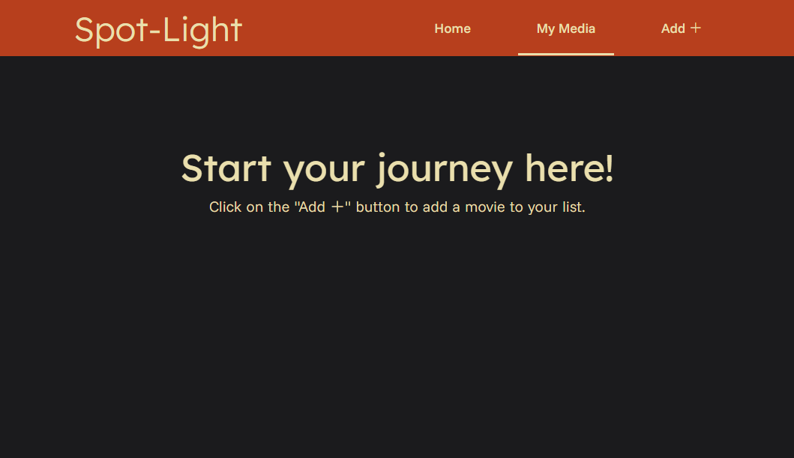
My Media Page
Here is where the true magic of the project happens. A big chunk of the logic behind this project resides in making this page work. Here is where the user inserts, updates, and deletes the media they list on the table.

